Slide 1
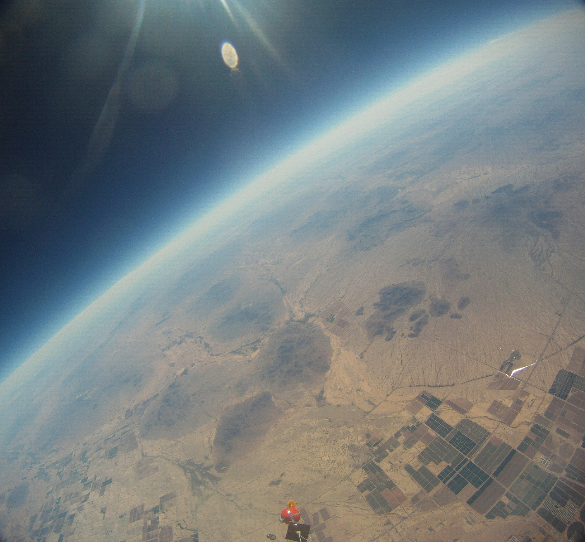




Team Co-op
The Engineering Institute
South Mountain Community College
Mark Blei
Brian Hegarty
Jeffery Spradley
Eric Mensen

Slide 2
Building the Payload
Etching Circuit Boards
Soldering
Designing The Payload
Installing Sensors

Slide 3
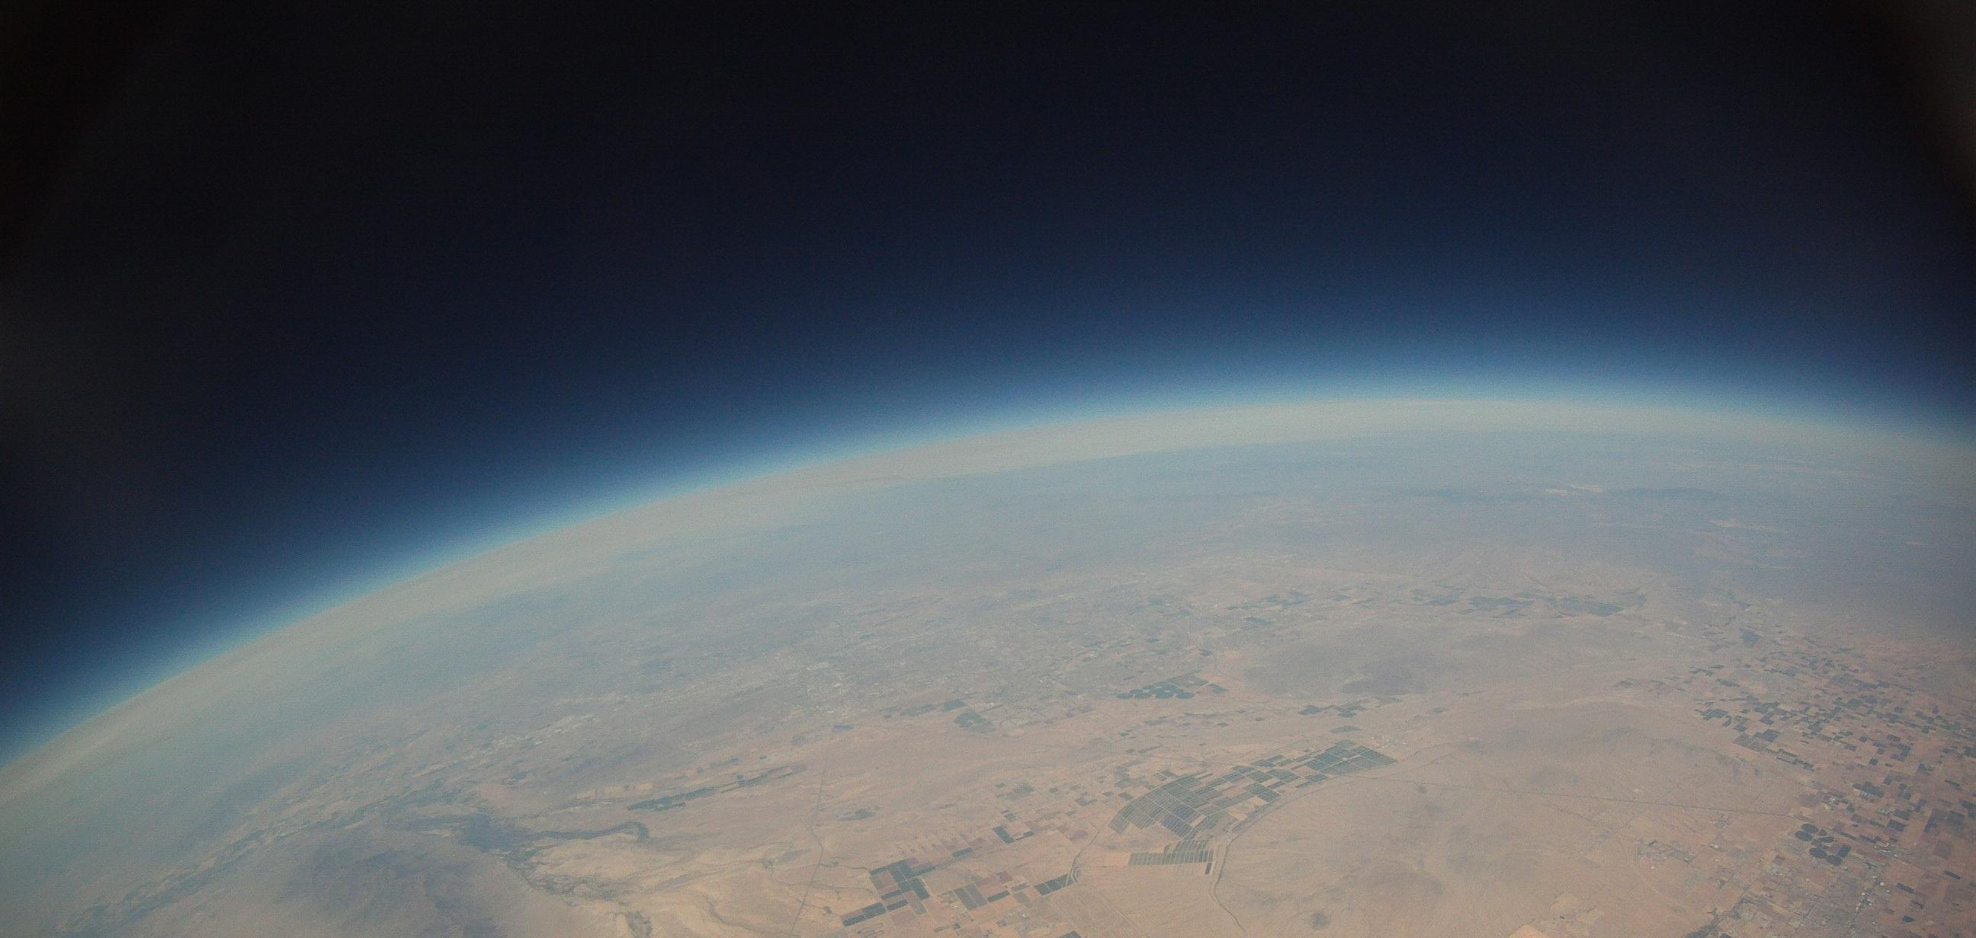
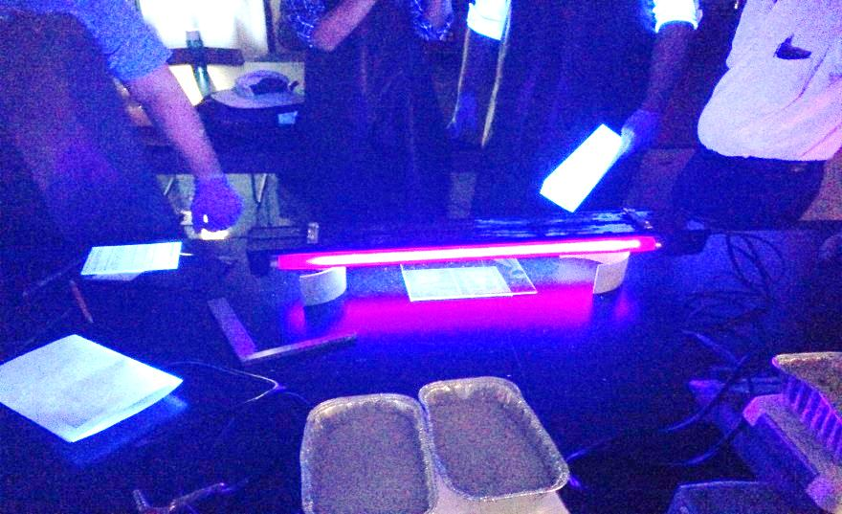
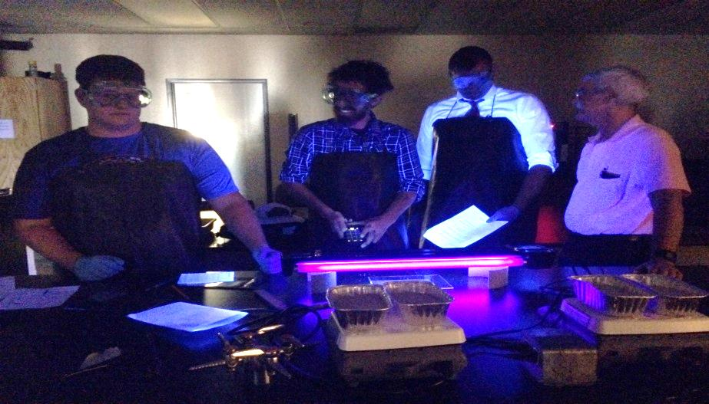
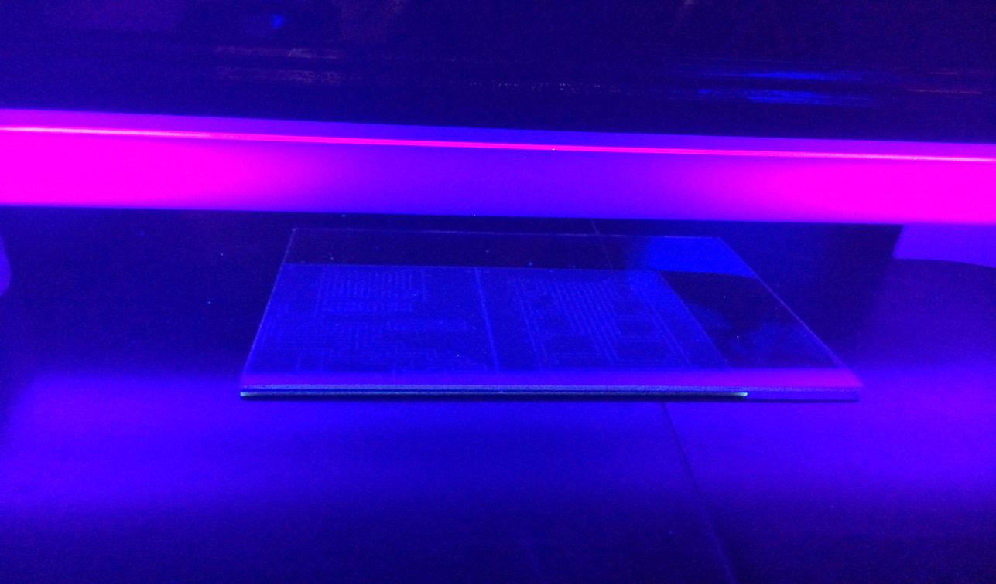
Etching the Circuit Board

Slide 4
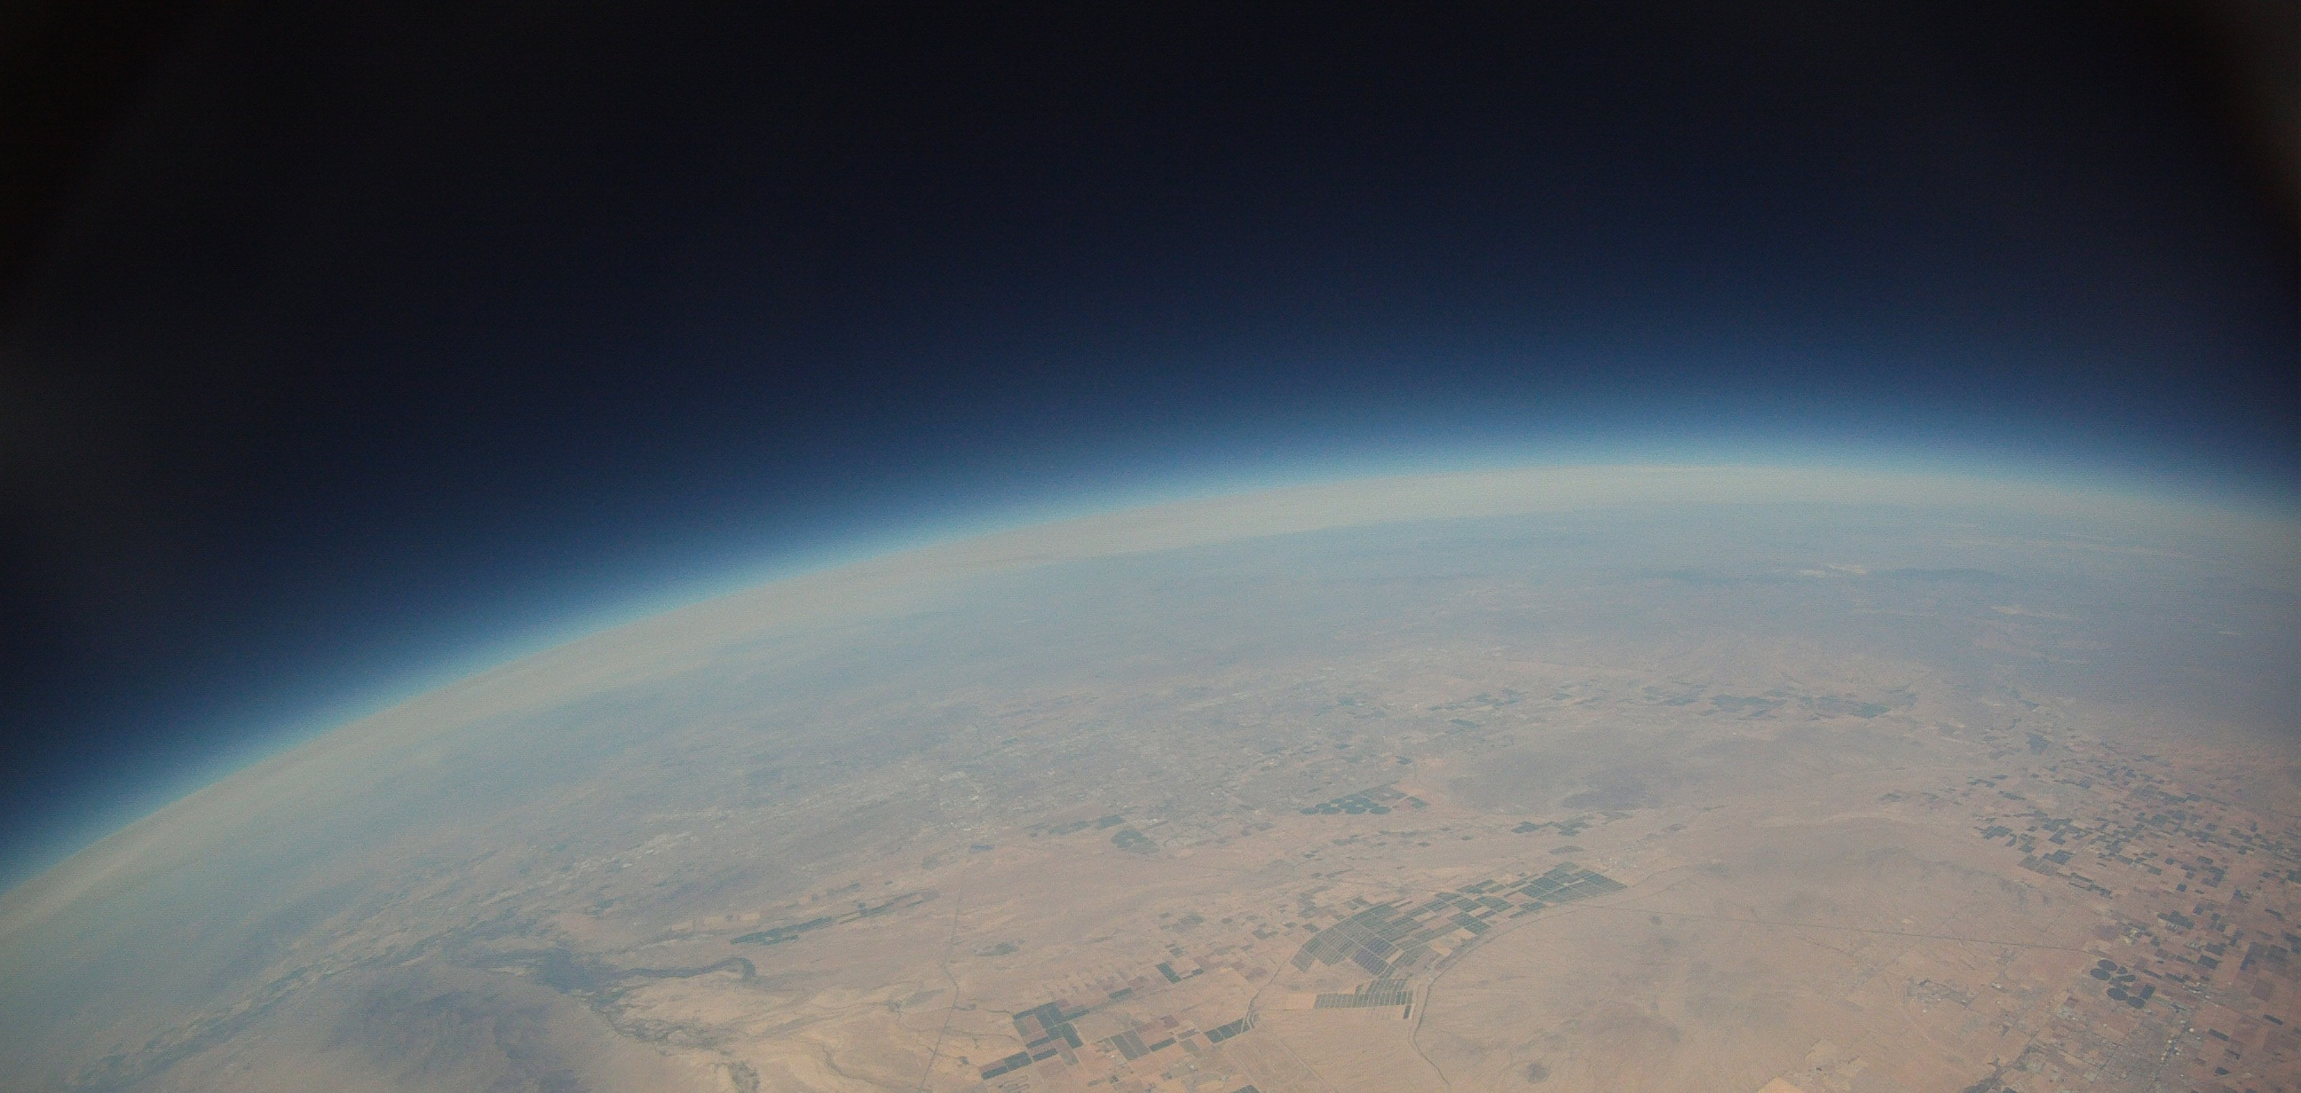
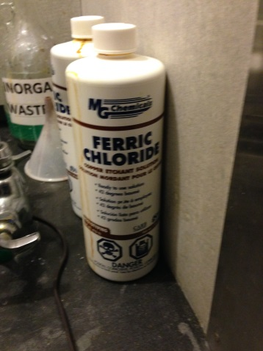
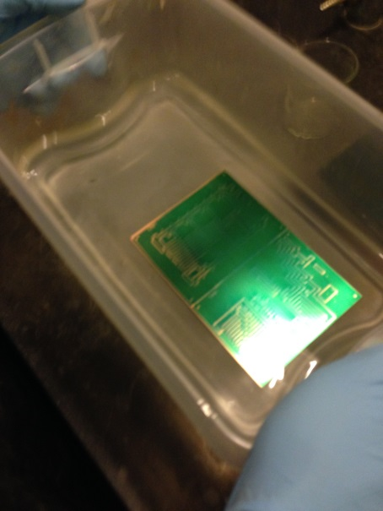
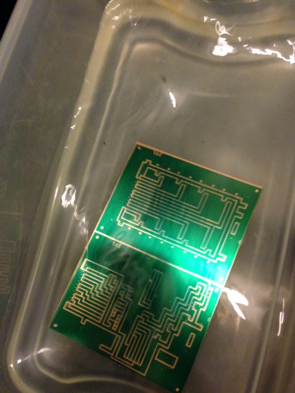
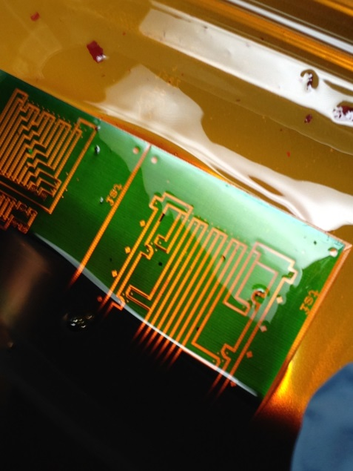
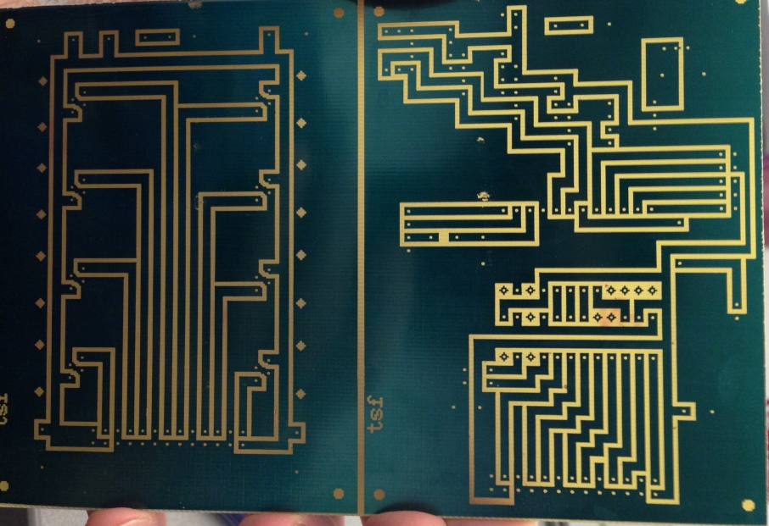
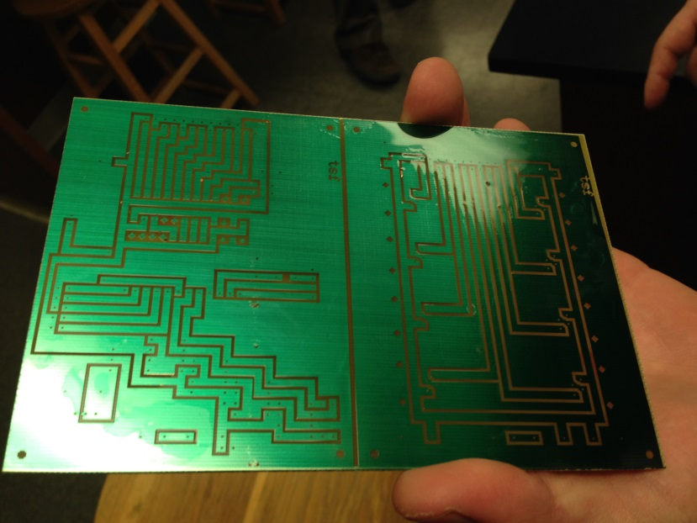
Process of Etching

Slide 5
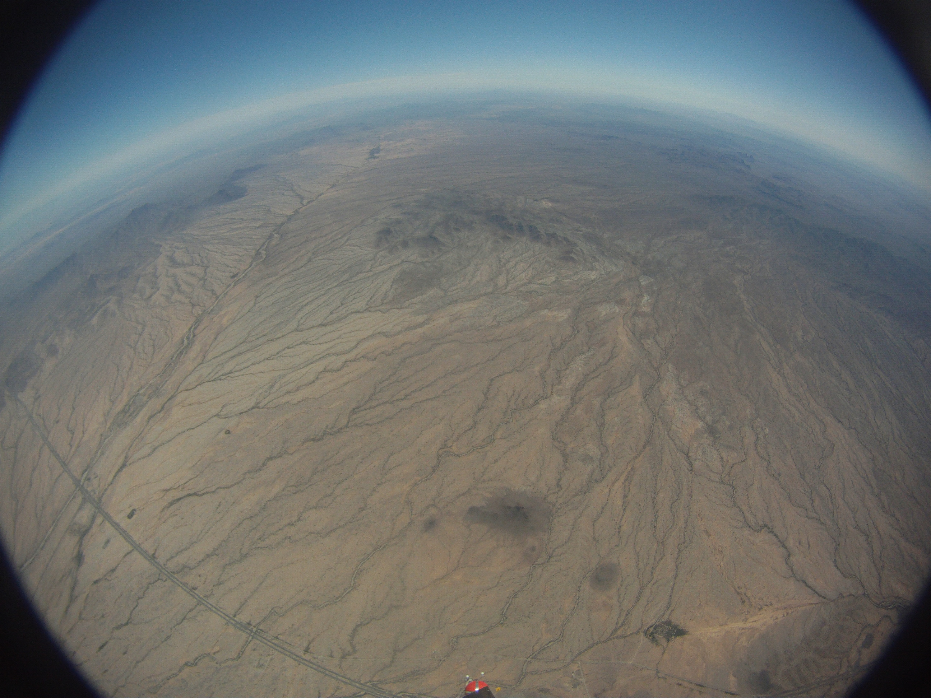
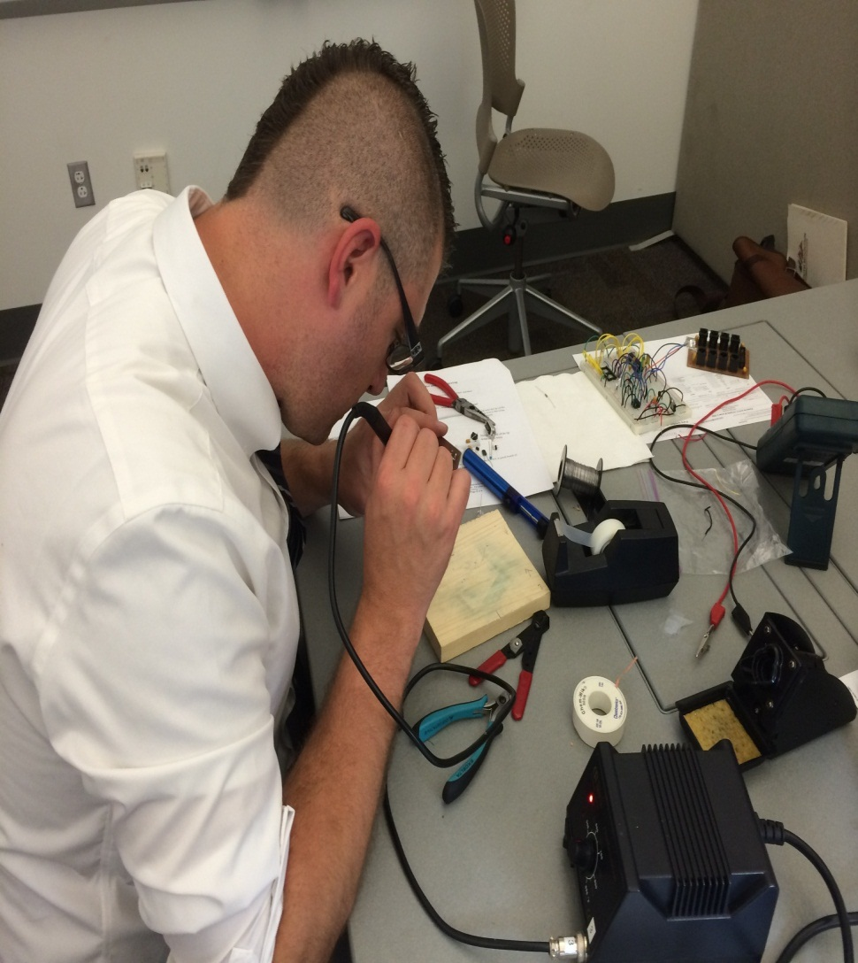
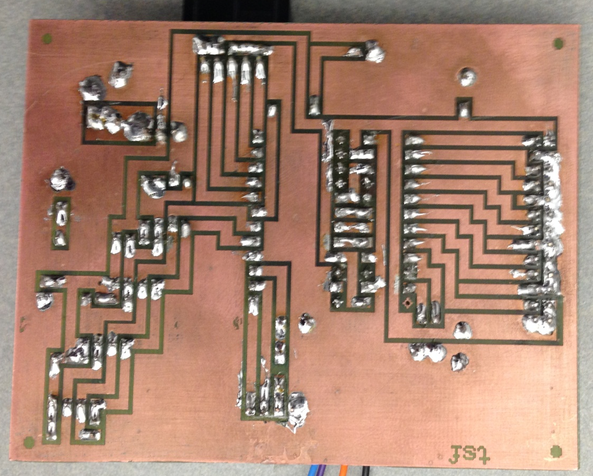
Soldering the Circuit Board

Slide 6
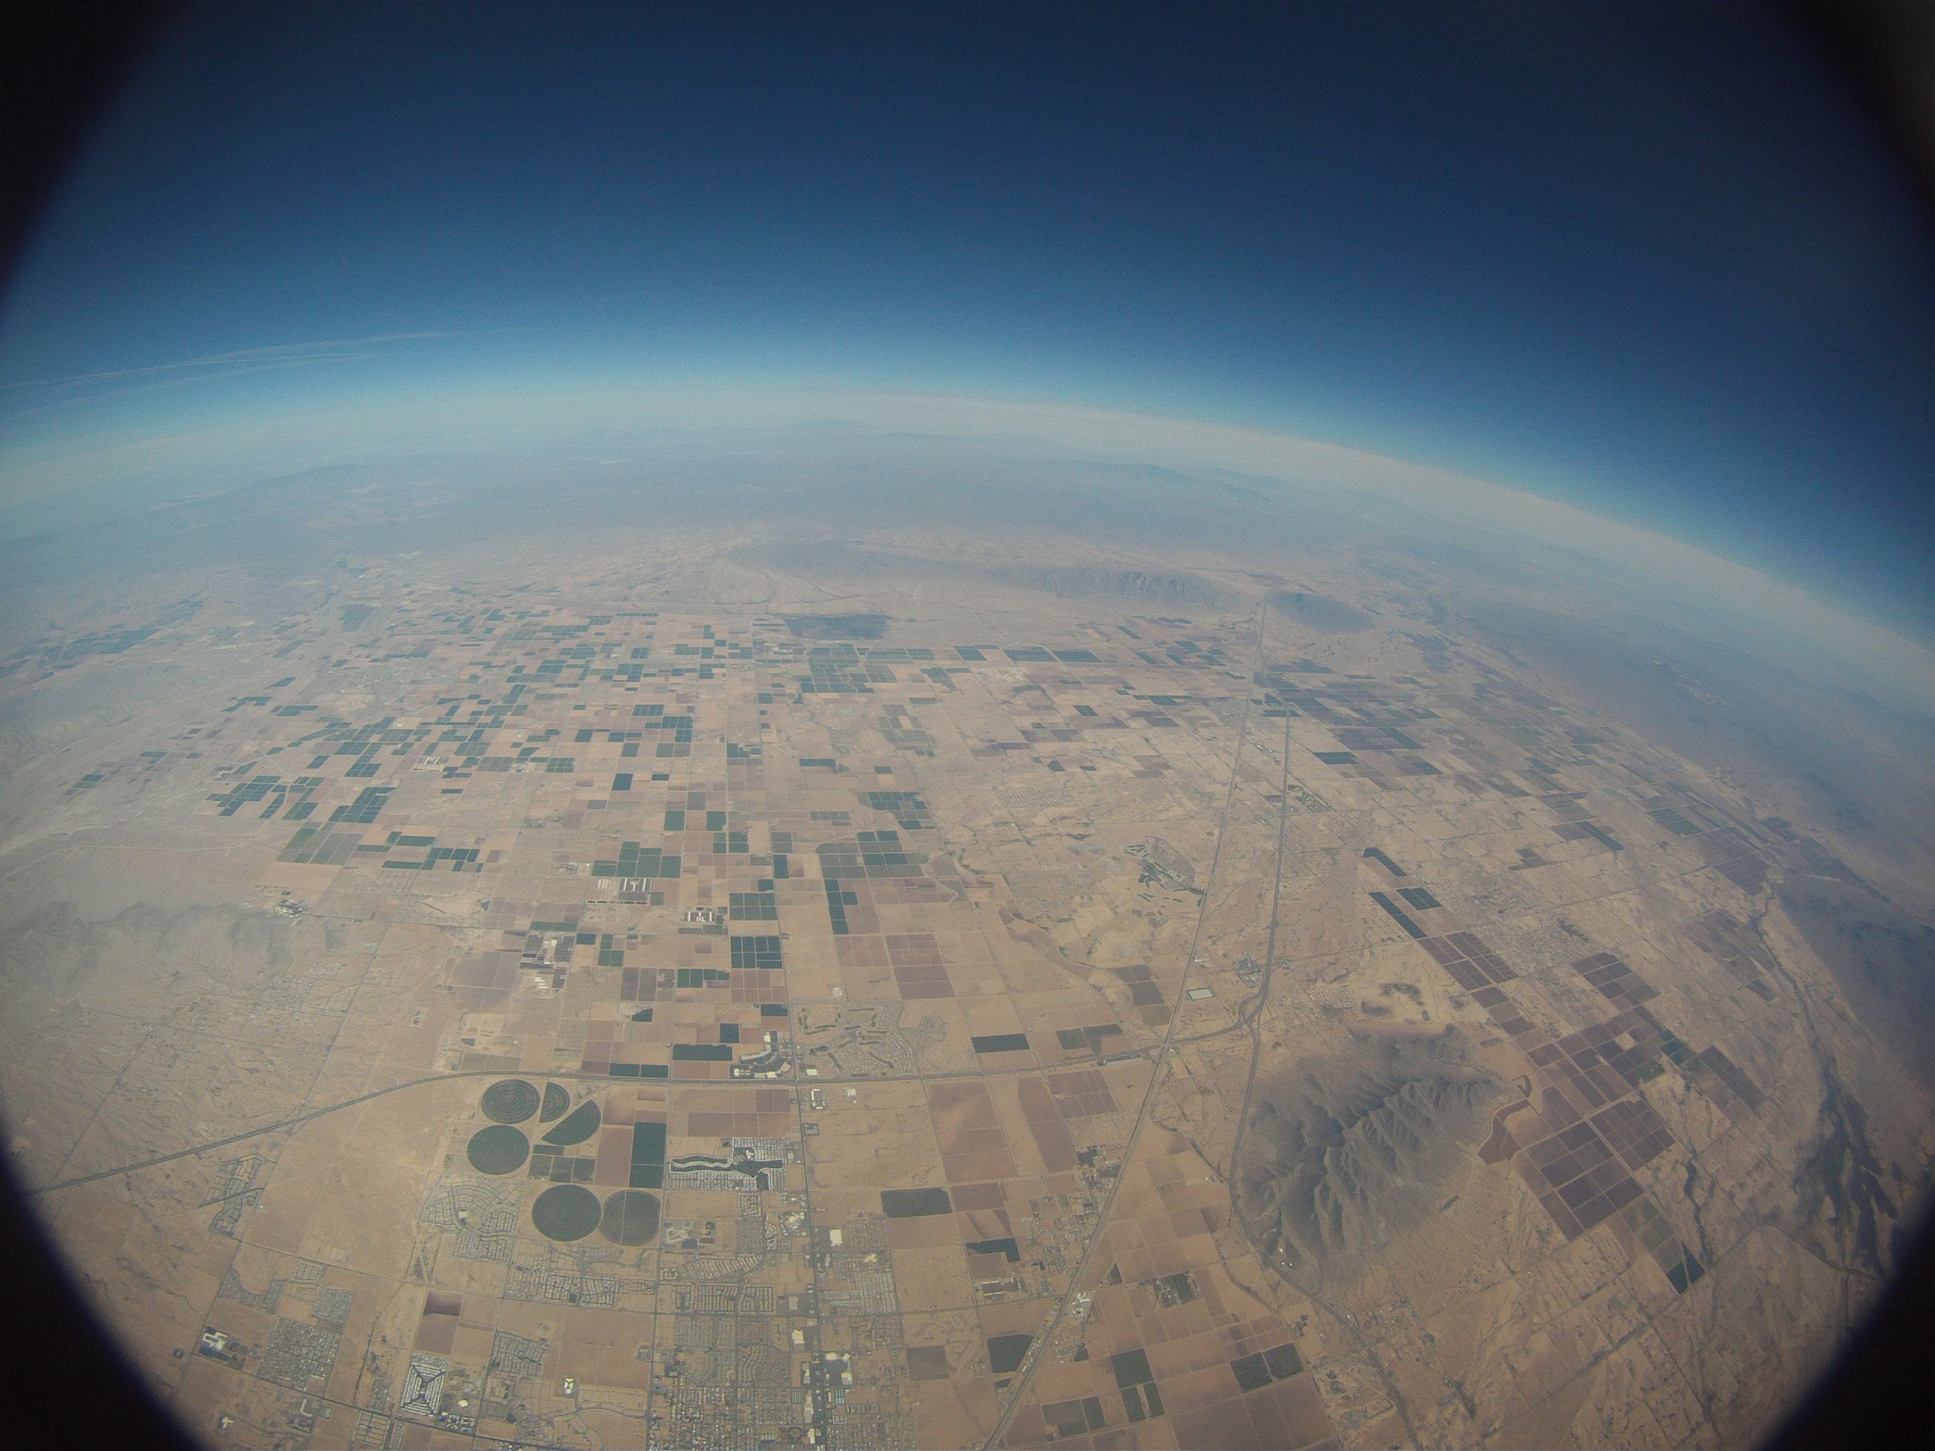
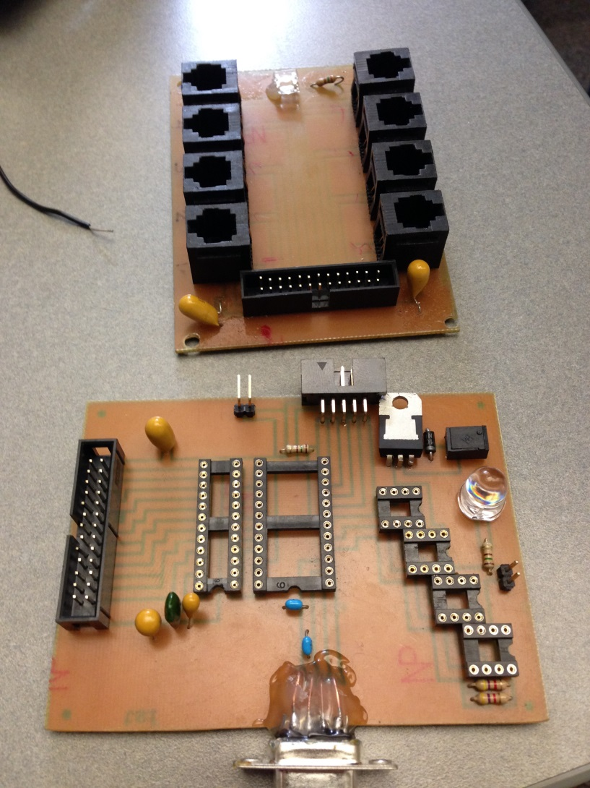
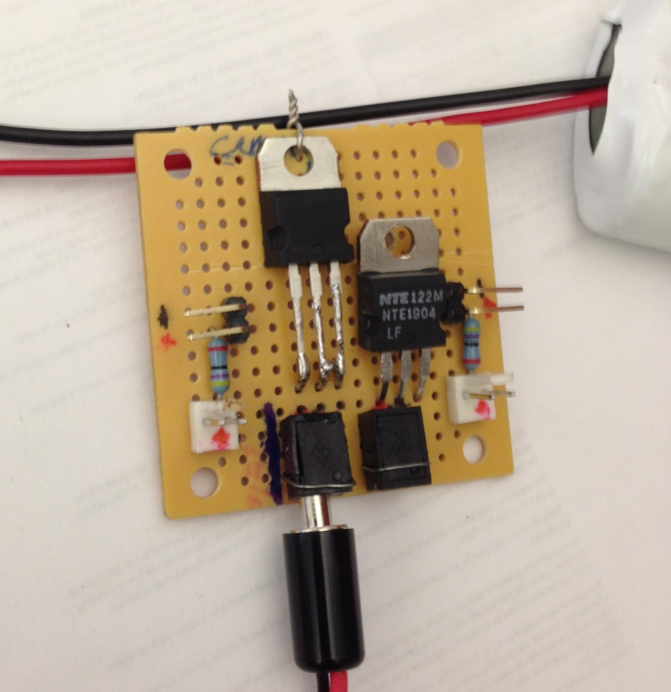
Circuit Boards

Slide 7
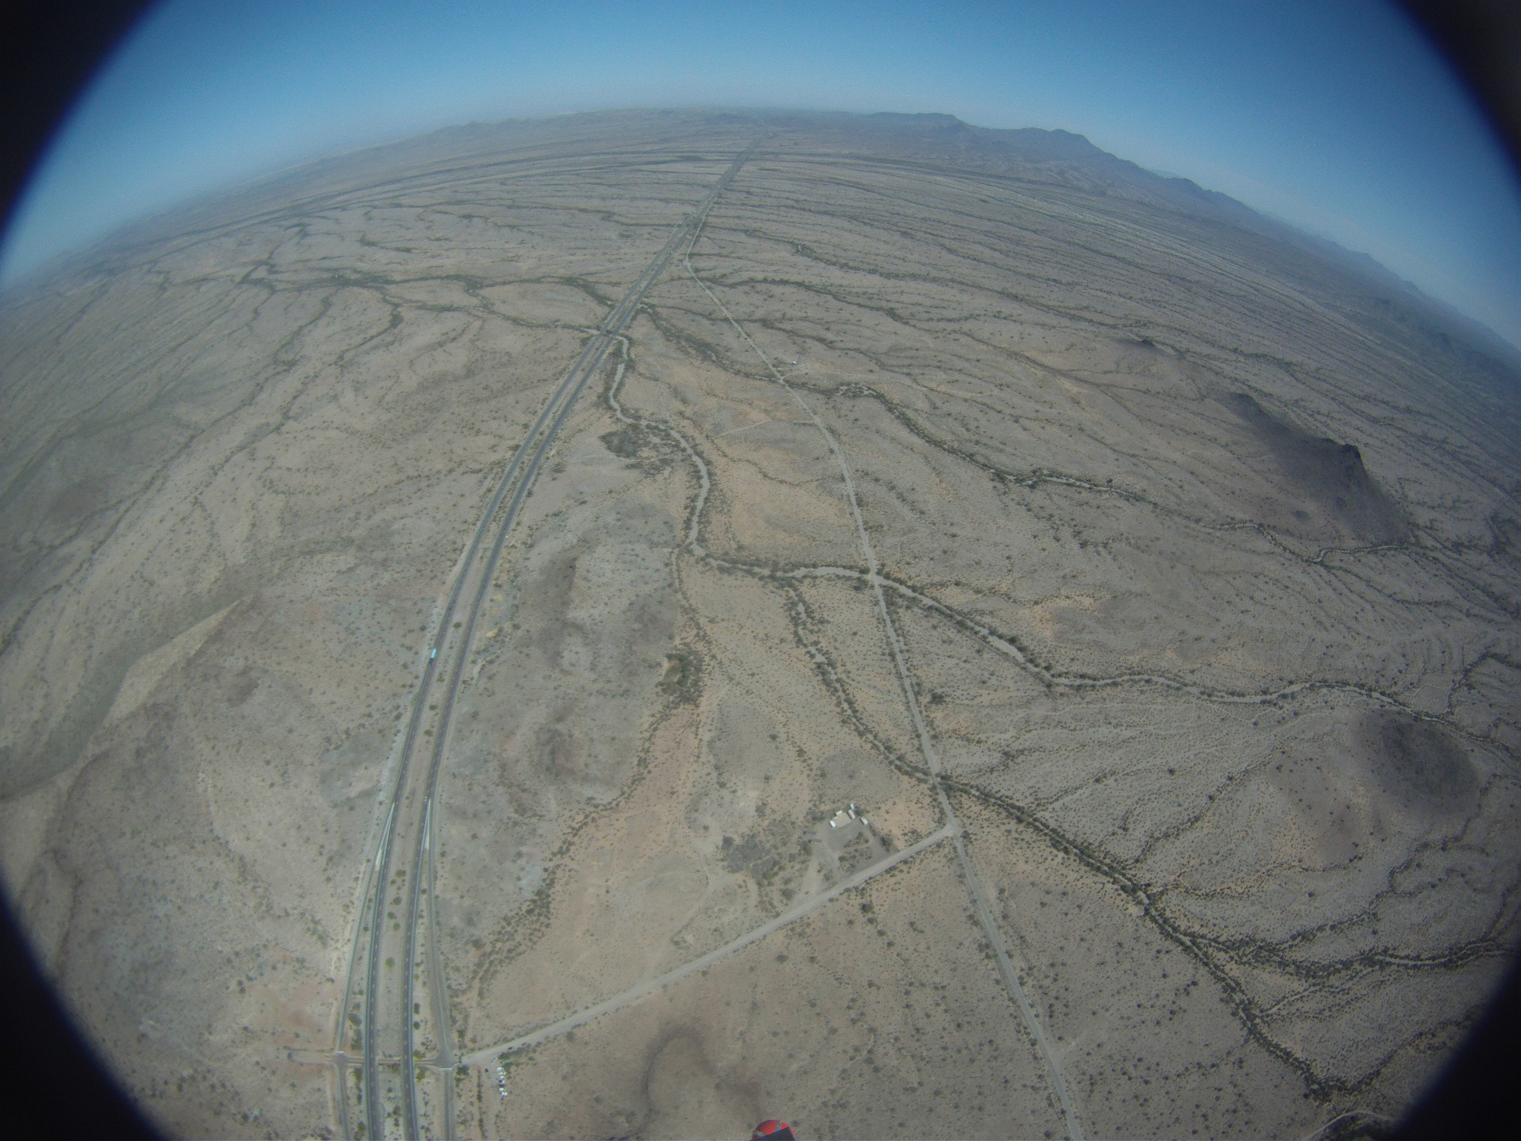
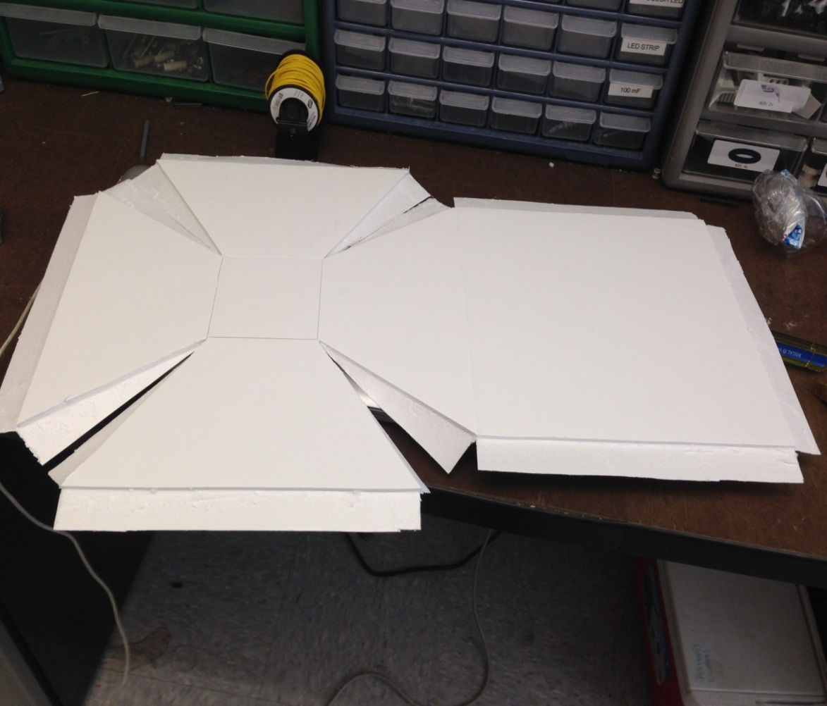
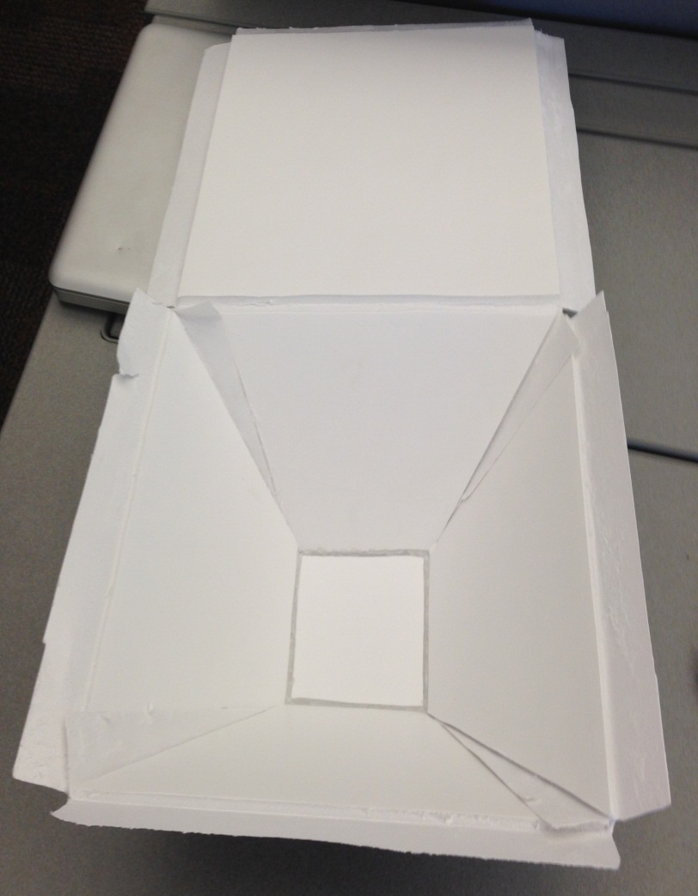
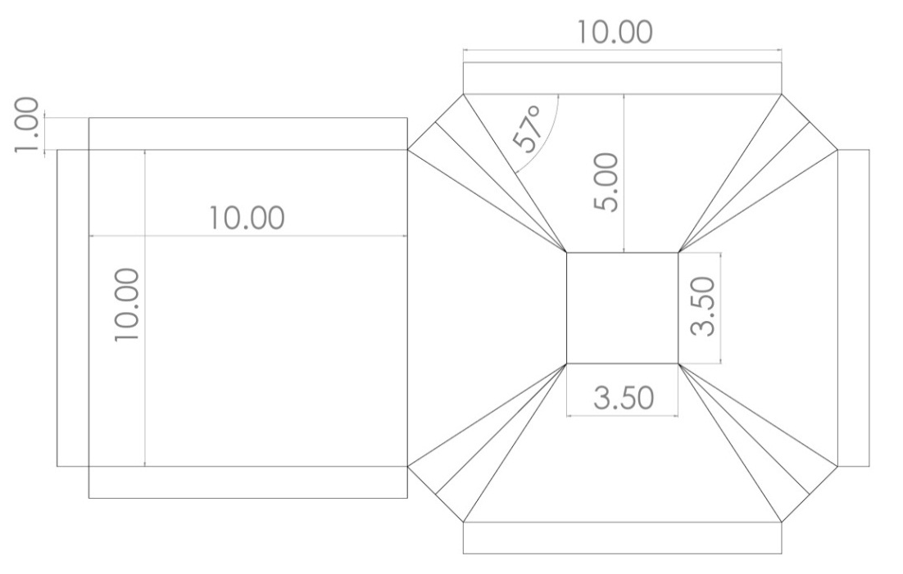
Designed in SolidWorks

Slide 8
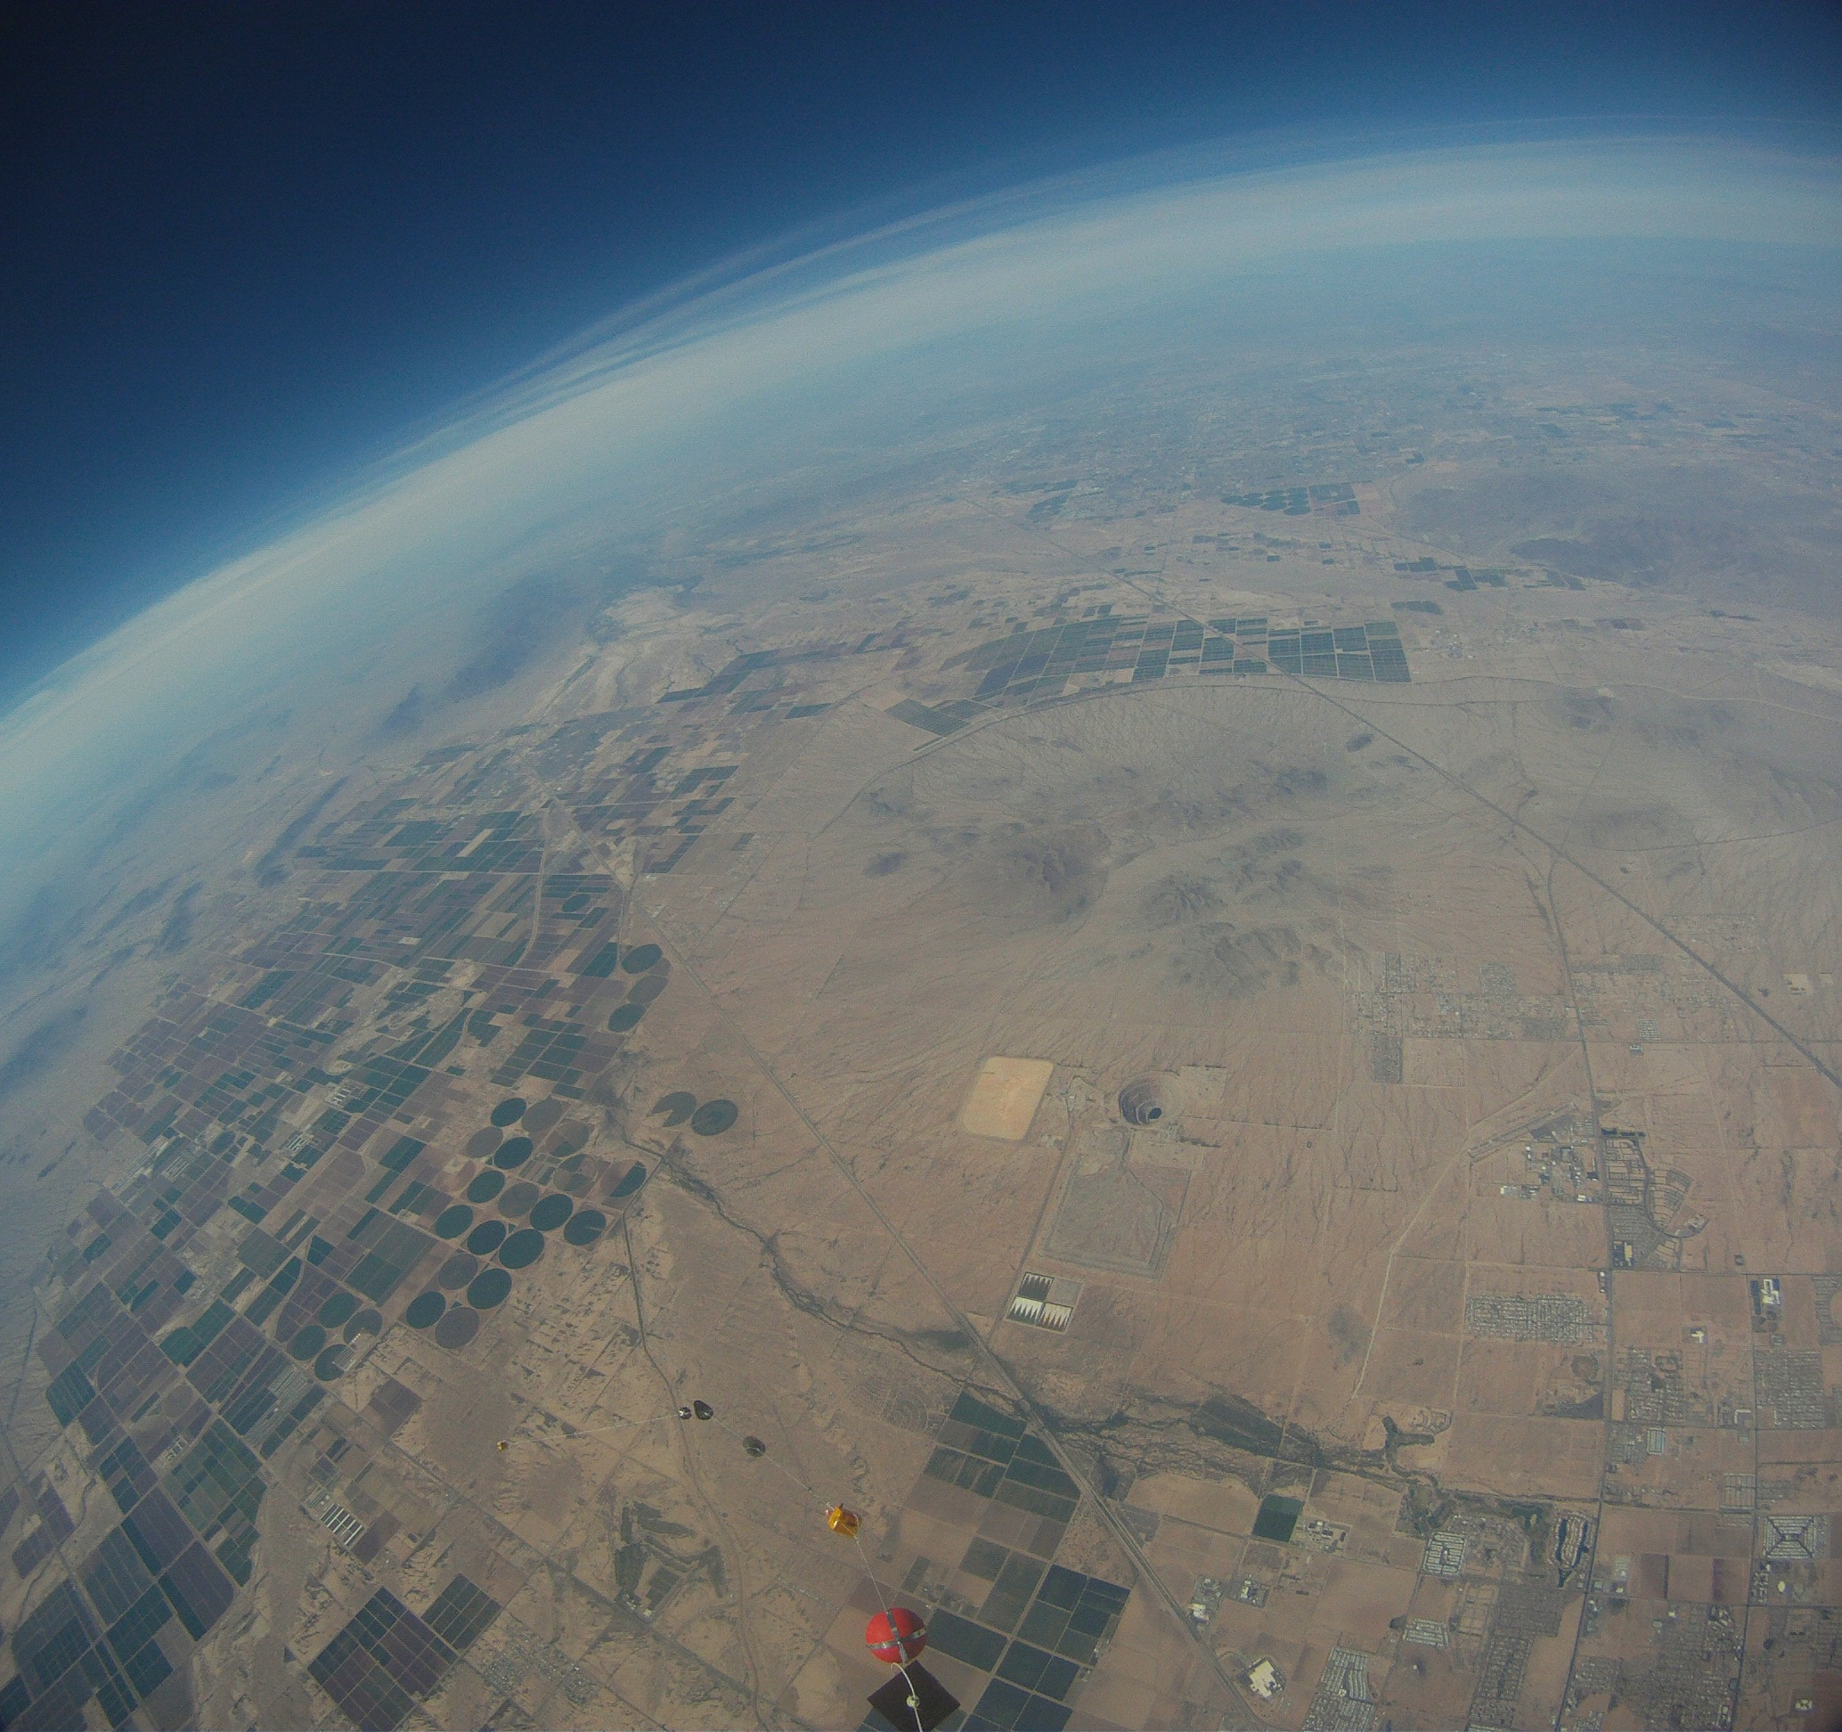
Sensors
Temperature – Interior and Exterior
Pressure
Accelerometer in the x and y direction
Humidity
Particulate Sensor
Still camera
Video camera

Slide 9
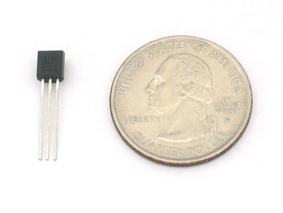
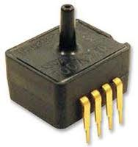
Temperature and Pressure
              Analog Devices TMP36
              Temperature Sensor
                Honeywell ASDX
                Silicon Pressure Sensor

Slide 10
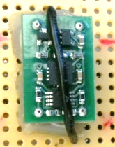
Accelerometer
            VTI Technologies SCA610 Series
            ±6g 2-D Accelerometer

Slide 11
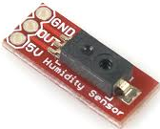
Humidity
Honeywell HIH-4030-003
Humidity Sensor

Slide 12
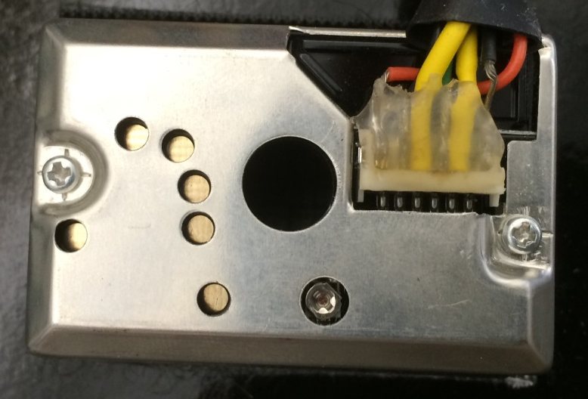
Airborne Particulates
Sharp GP2Y1010AU0F
Compact Optical Dust Sensor

Slide 13
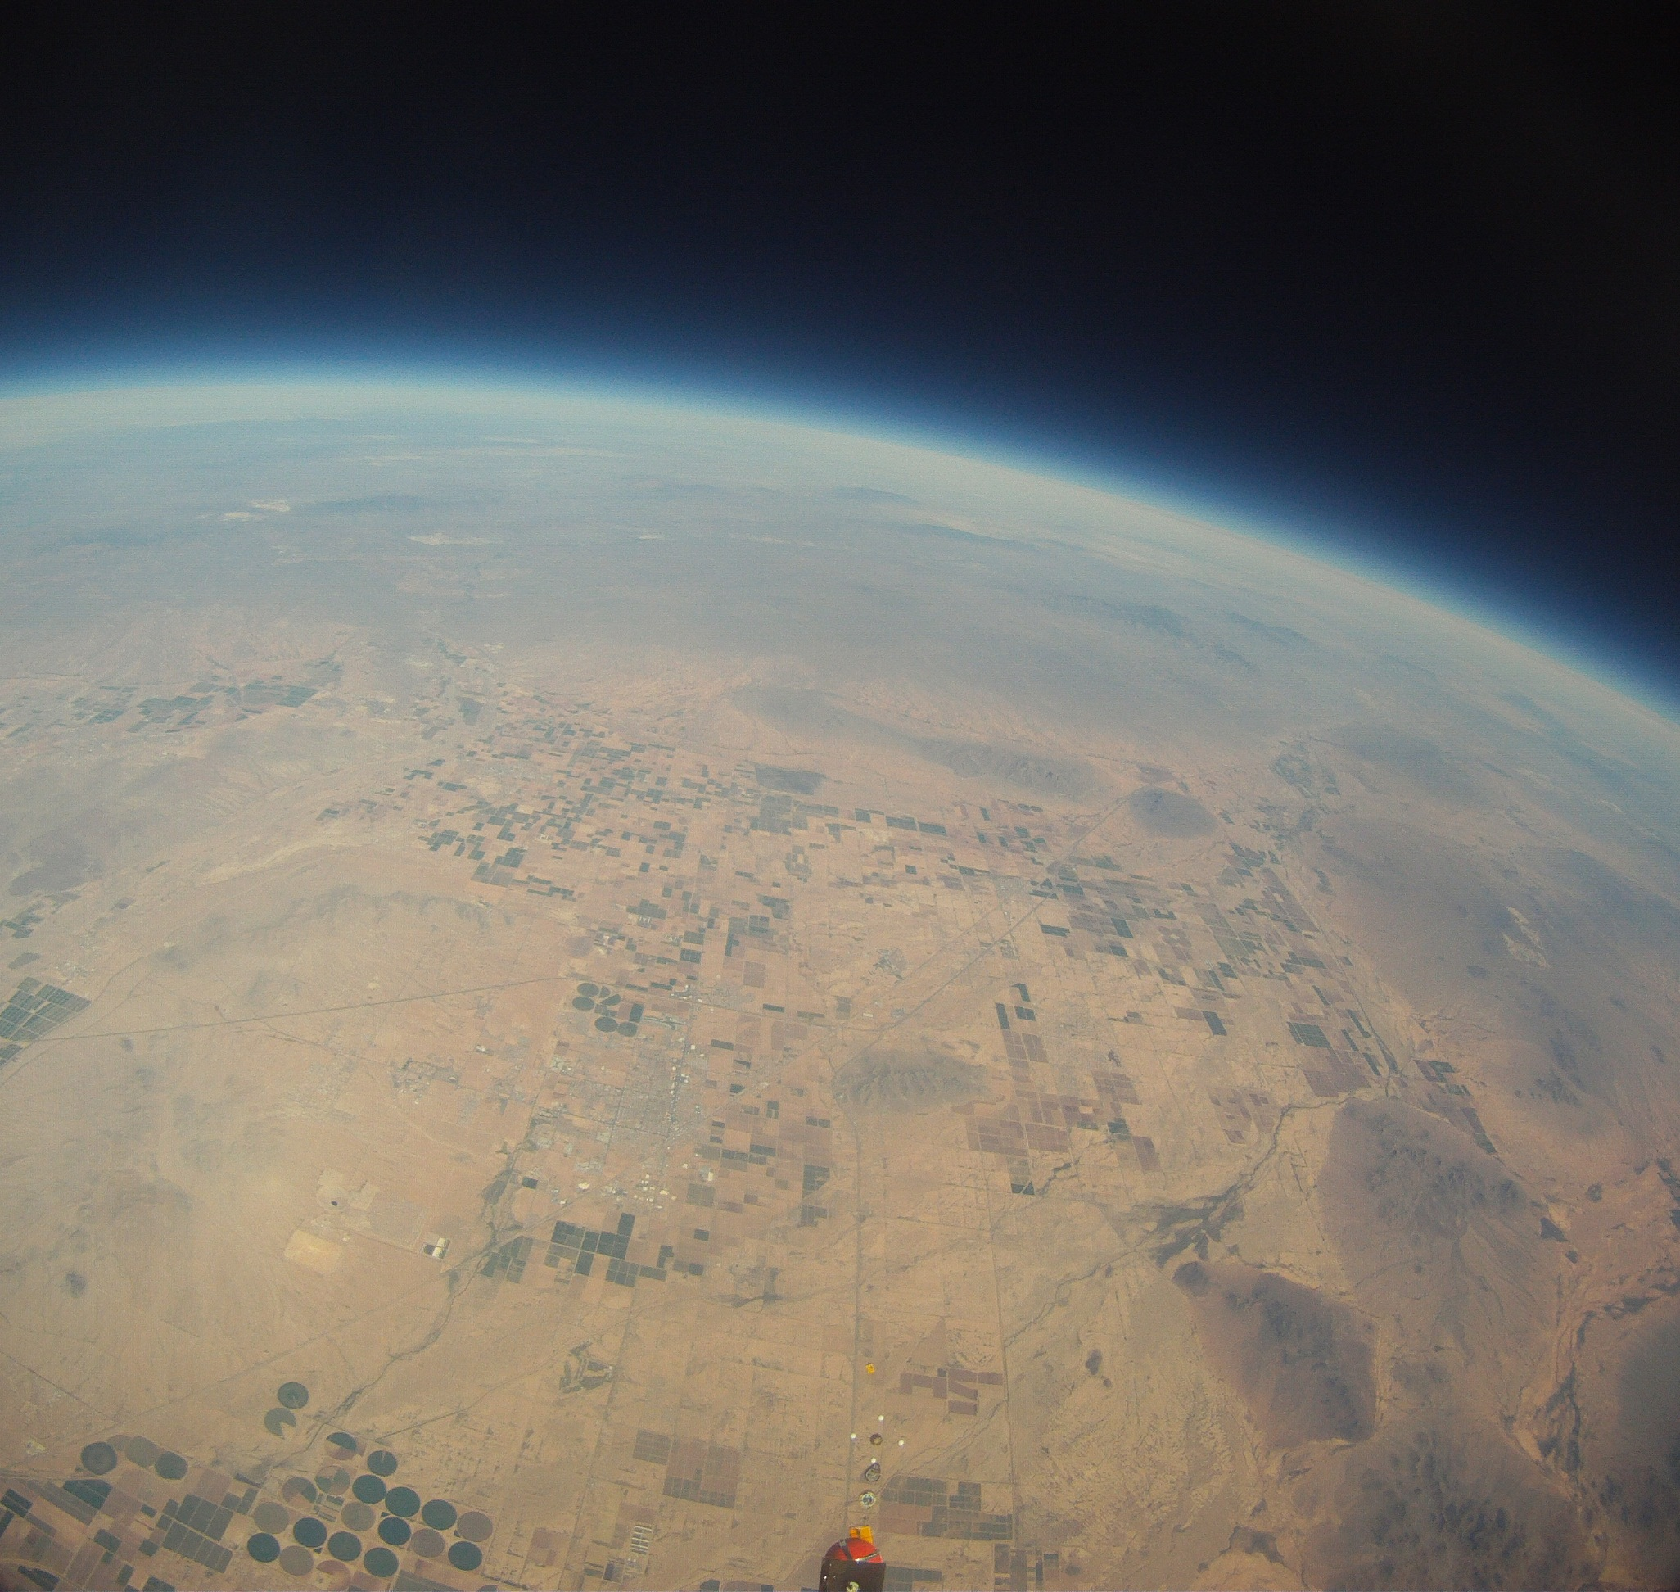
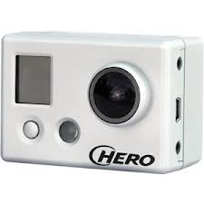
GoPro
Took pictures every 30 seconds
Res: 1080p

Slide 14
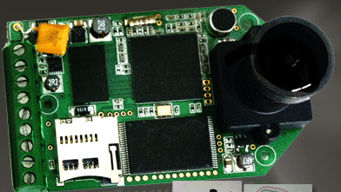
Hack HD
Res: 1080p HD
30 FPS
160 degree wide angle lens

Slide 15
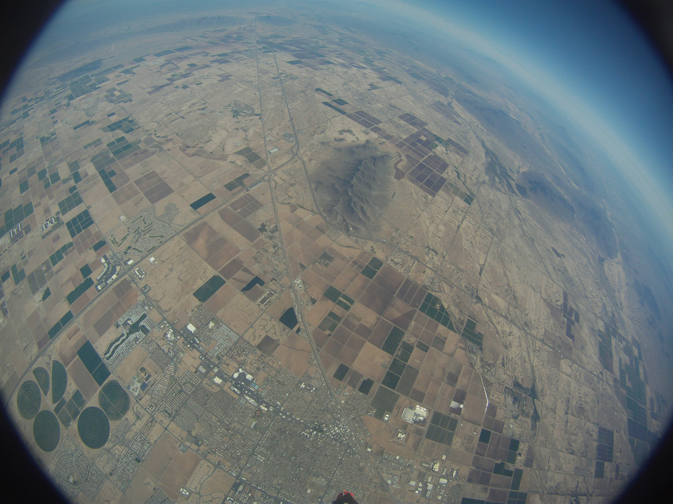
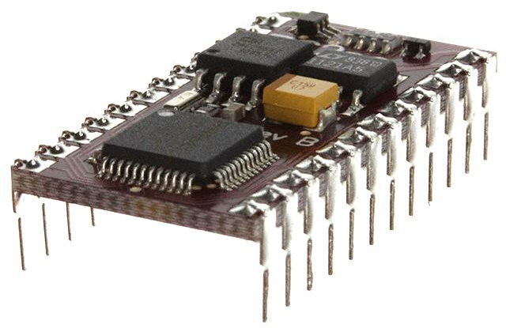
Microprocessor
Basic Stamp - BS2pe-IC
8MHz of processing speed
5V DC

Slide 16
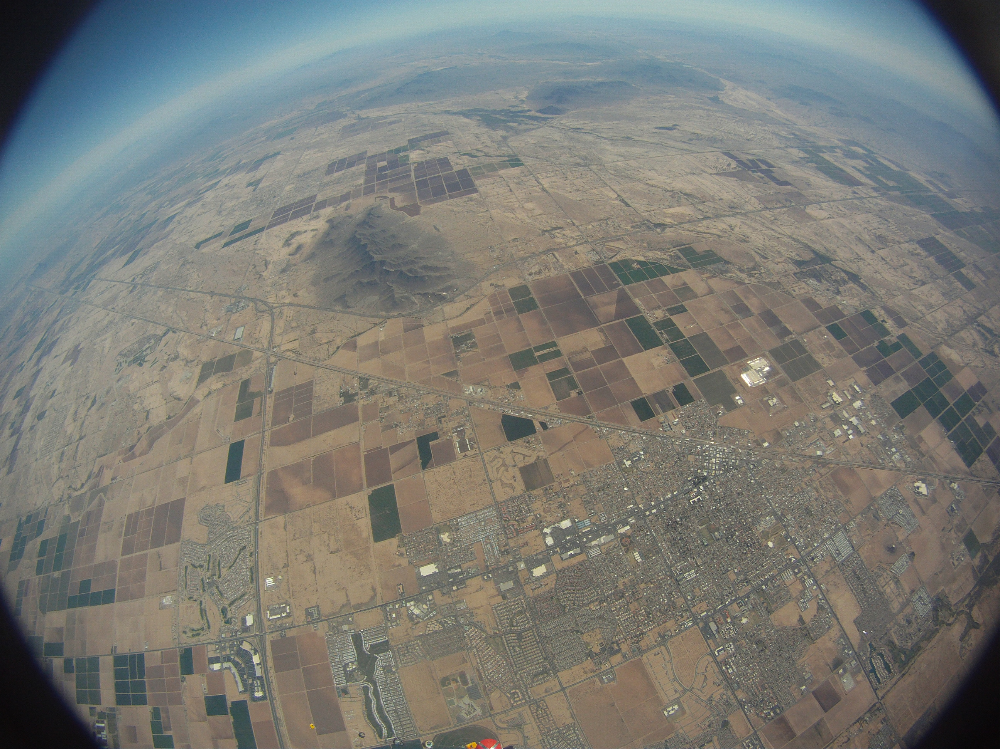
Computer Programing
Set number of sensors (7)
Set sampling rate (0.65s)
Data Stored in EEPROM

Slide 17
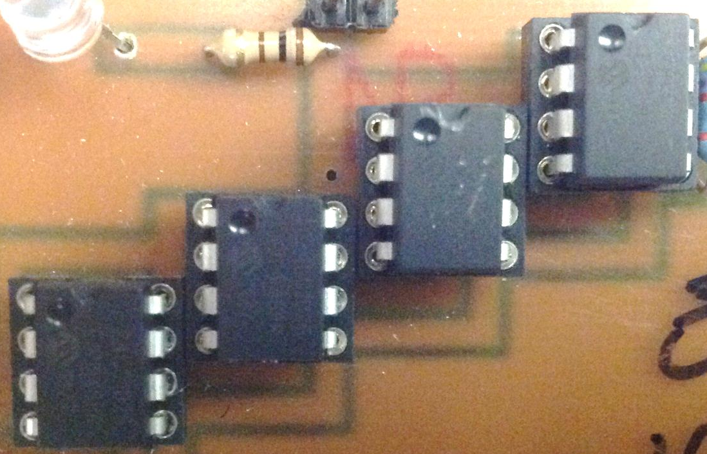
EEPROM
4 EEPROM Memory Chips
Total storage capacity is 512 Kb

Slide 18
System Block Diagram
Battery
Sensor Bay
Analog/Digital Converter
Microprocessor
Camera
Memory

Slide 19
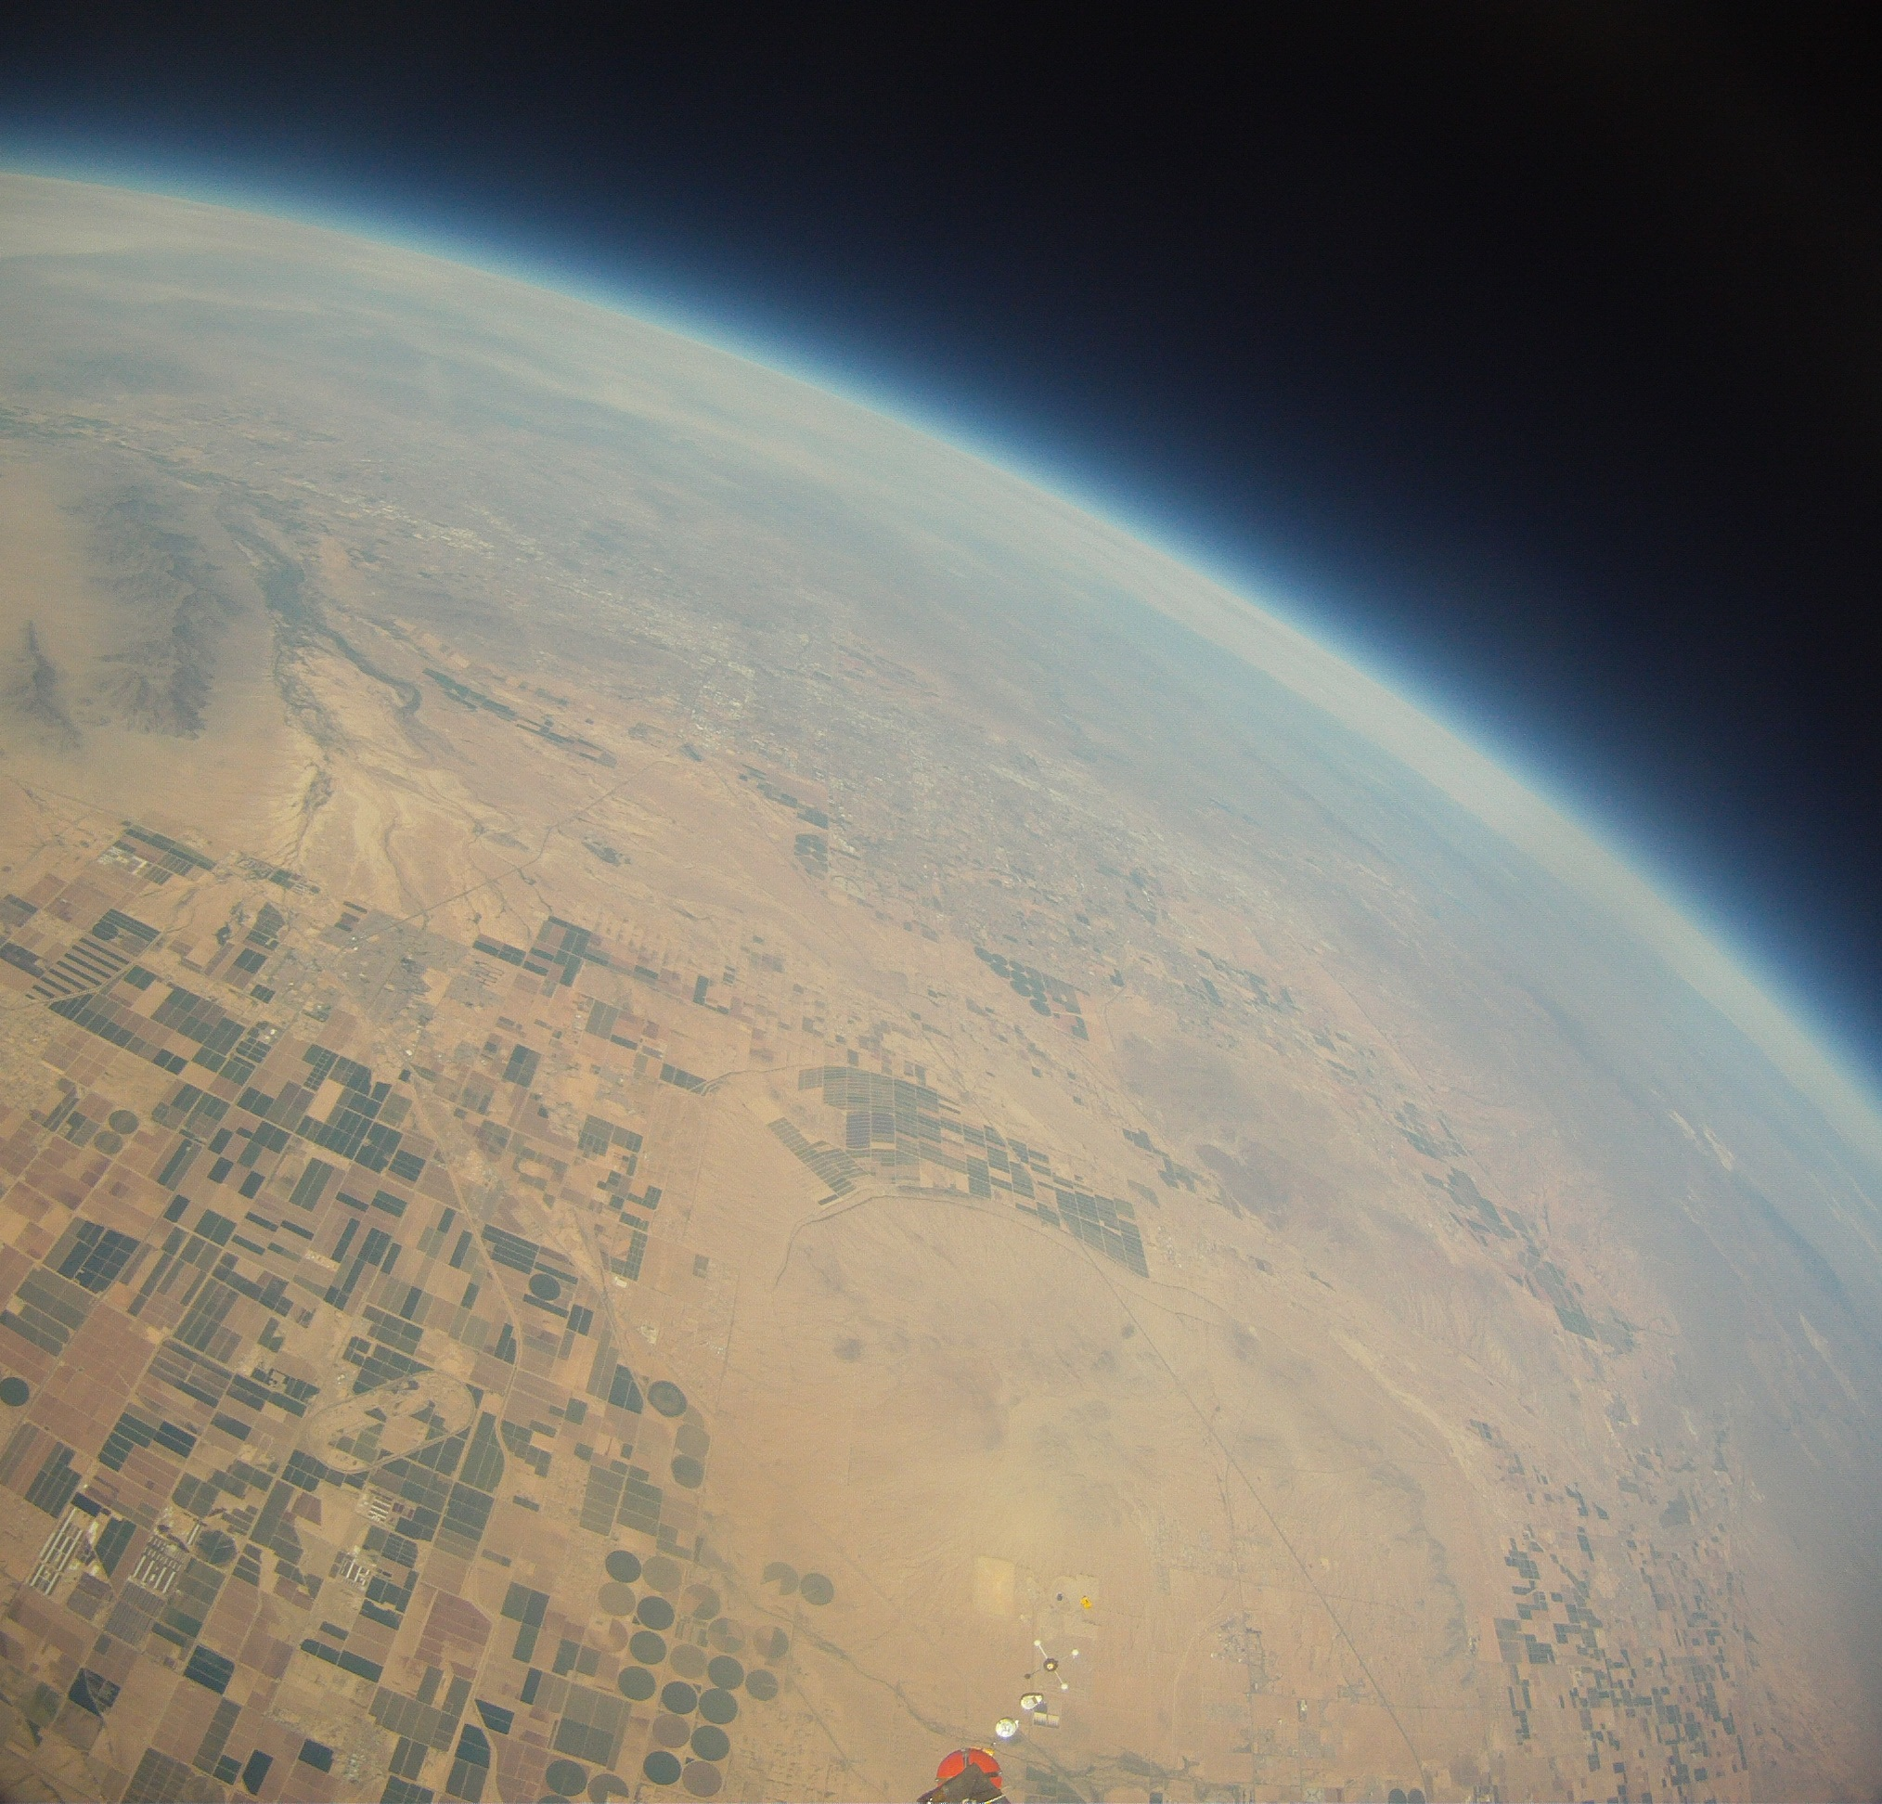
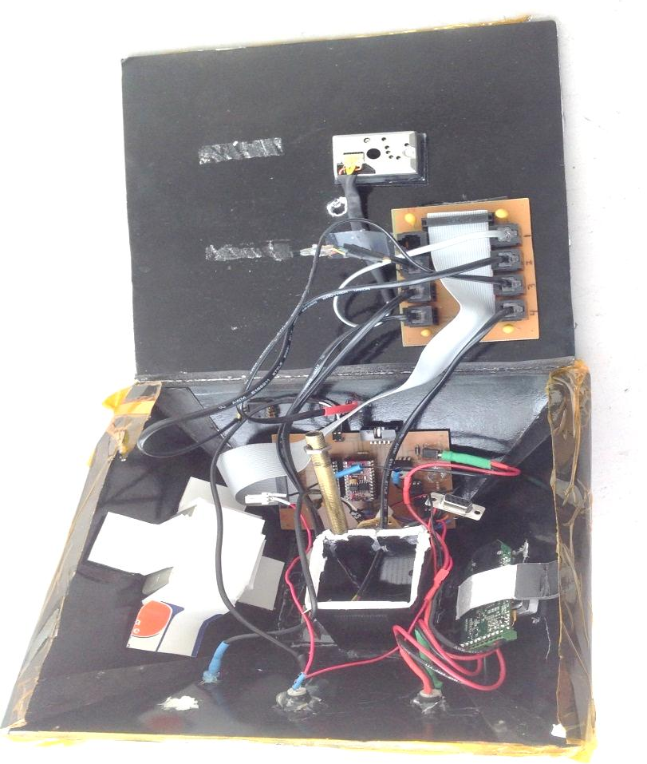
Flight Data

Slide 20
Temperature
Interior & Exterior

Slide 21
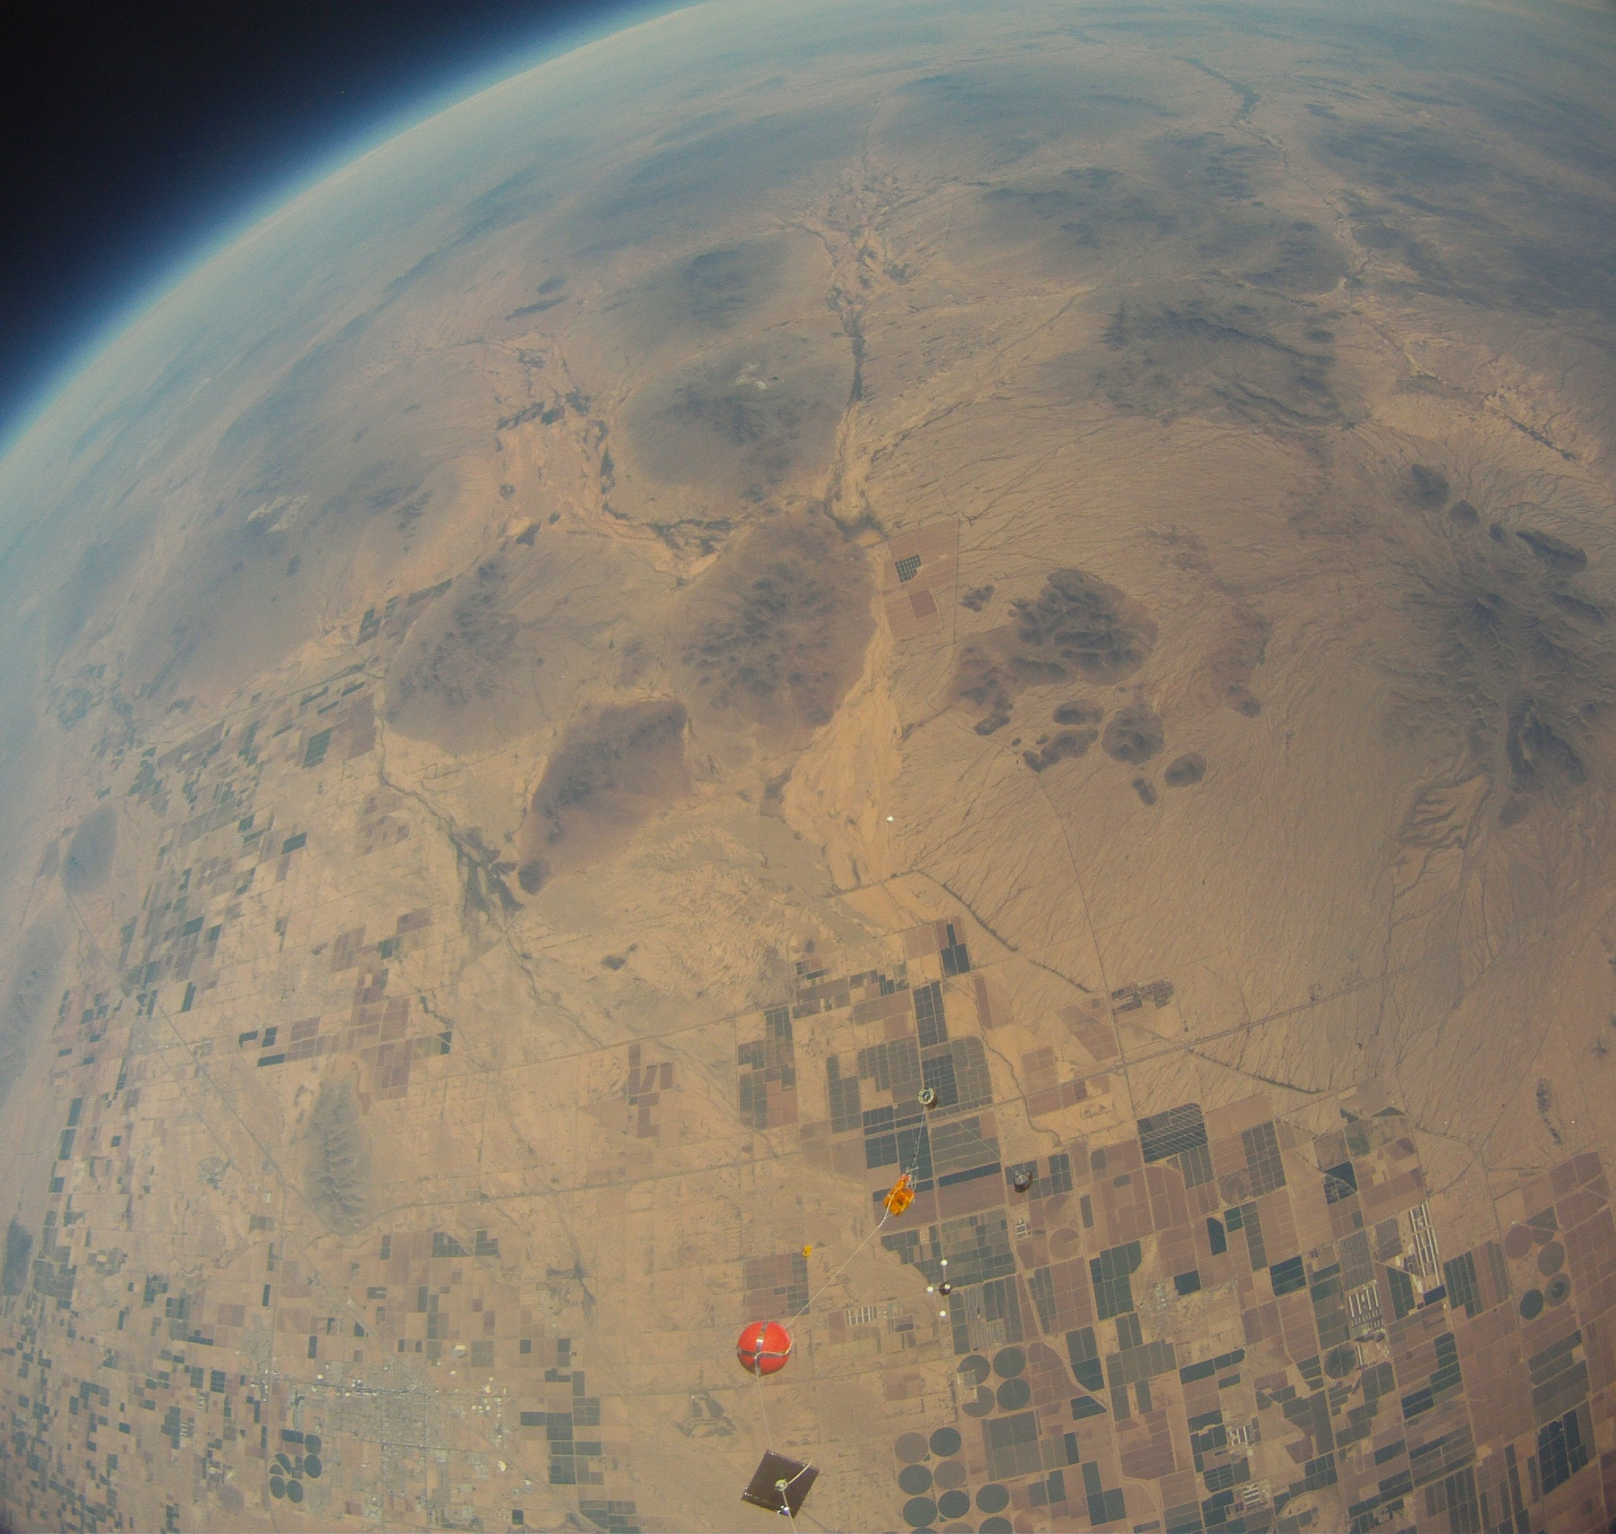
Pressure

Slide 22
Accelerometer X Direction
Burst
Launch

Slide 23
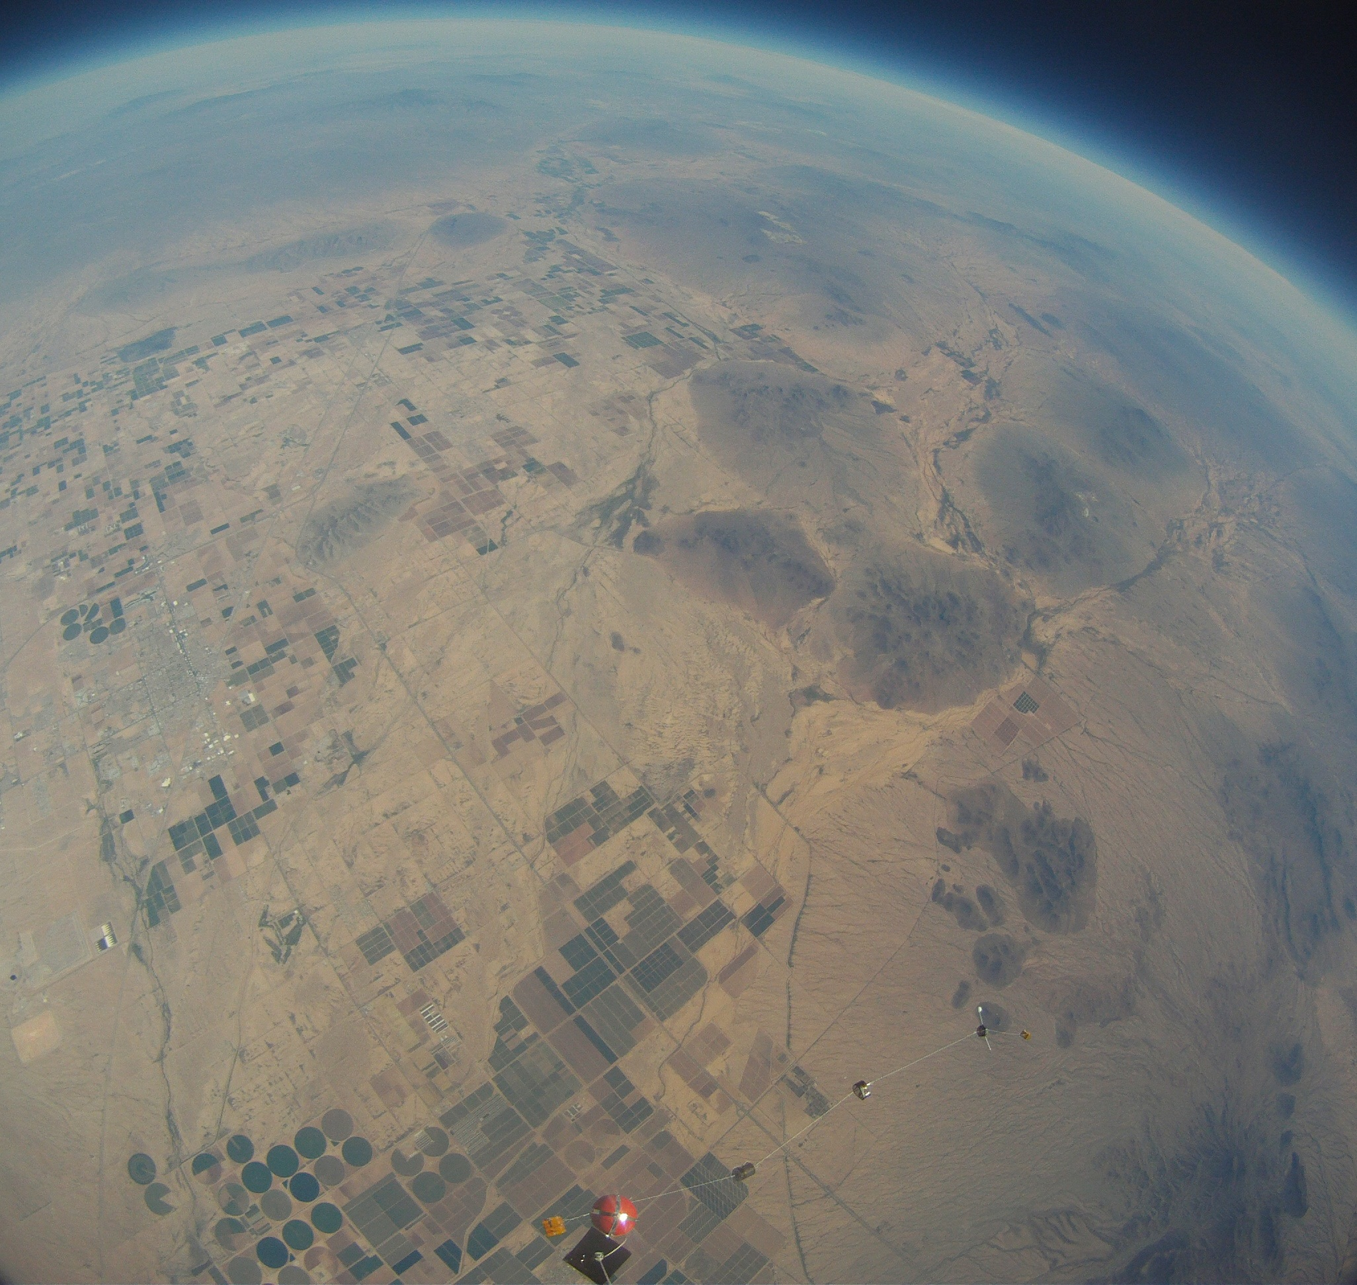
Accelerometer Y Direction
Burst
Launch

Slide 24
Humidity

Slide 25
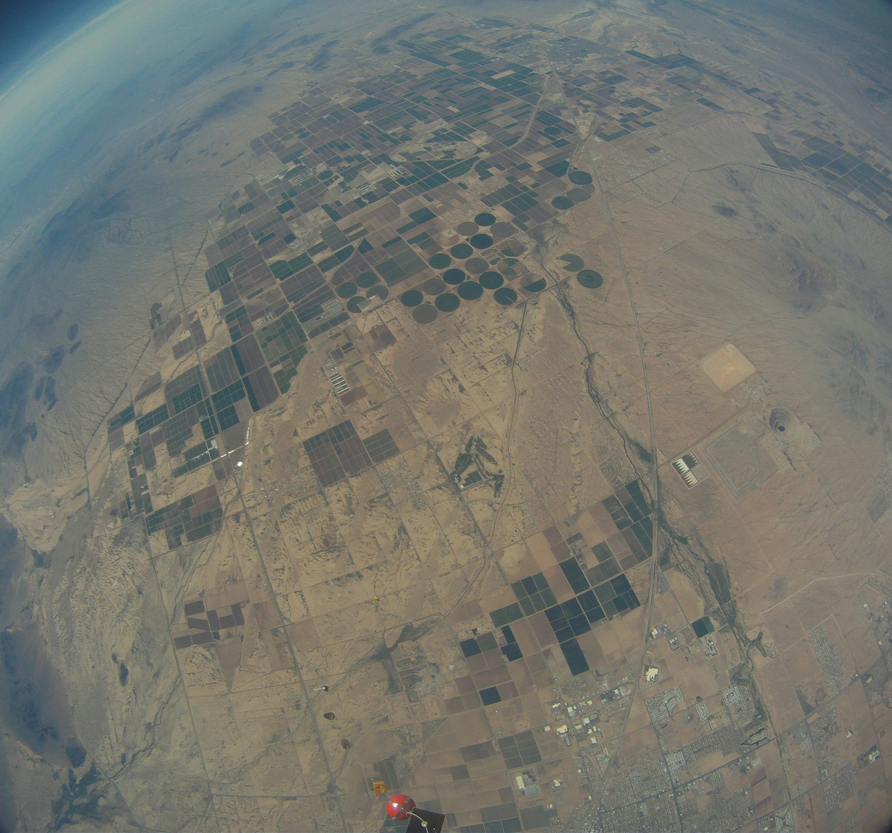
Airborne Particulates

Slide 26
Acknowledgements
Dr. Tim Frank
Rick Sparber
Arizona Space Grant Consortium
ANSR
NASA
South Mountain Engineering Department
Phoenix College for sending us Mark
GCC Scholarship Bowling Team

Slide 27
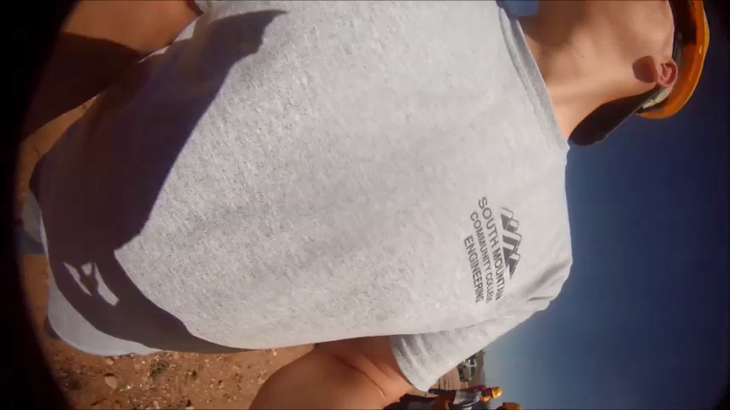

Slide 28
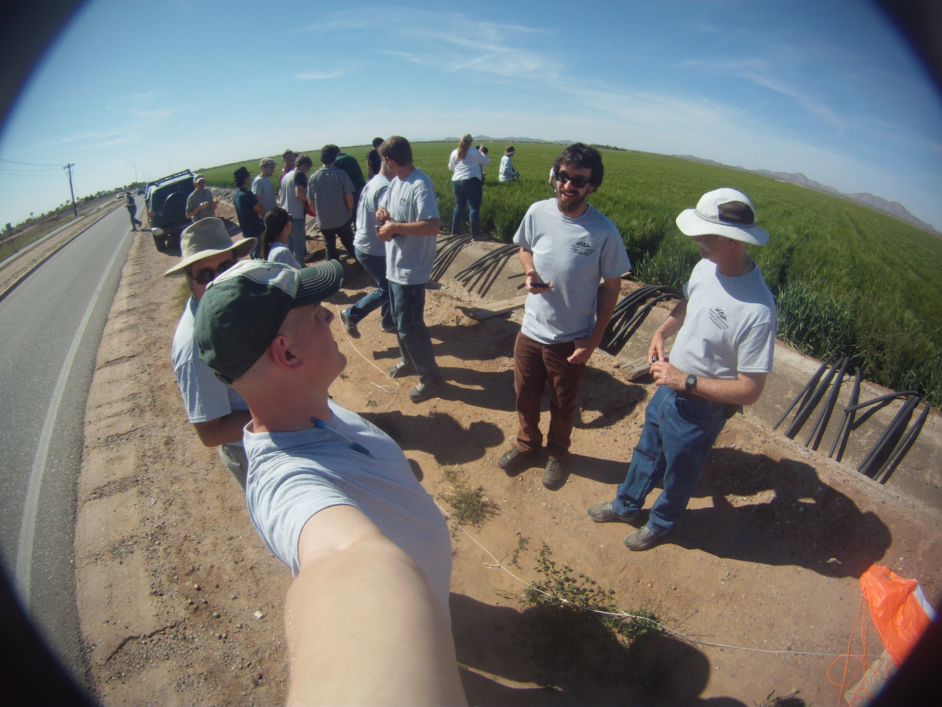
Questions?

